Slide 1
Input-Output Organization : I/O Interface
Lecture 40-42

Slide 2
Input-Output Interface
Input-output interface provides a method for transferring information between internal storage and external I/O devices.
Peripherals connected to a computer need special communication links for interfacing them with the central processing unit.
The purpose of the communication link is to resolve the differences between the central computer and each peripheral.
IO interface provides a method for transferring information between internal storage and external I/O devices.
I/O devices can not directly communicate with the CPU due to various differences between them.

Slide 3
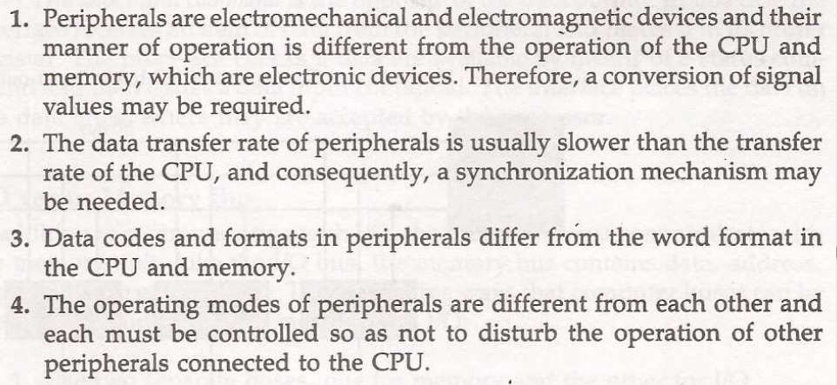

Slide 4
Differences between Computer and Peripheral Devices
The communication link resolves the following differences between the computer and peripheral devices.
1. Devices and signals
Peripherals - Electromechanical Devices
CPU or Memory - Electronic Device
2. Data Transfer Rate
Peripherals - Usually slower
CPU or Memory - Usually faster than peripherals
Some kinds of Synchronization mechanism may be needed
3. Unit of Information
Peripherals - Byte
CPU or Memory - Word
4. Operating Modes
Peripherals - Autonomous, Asynchronous
CPU or Memory – Synchronous

Slide 5
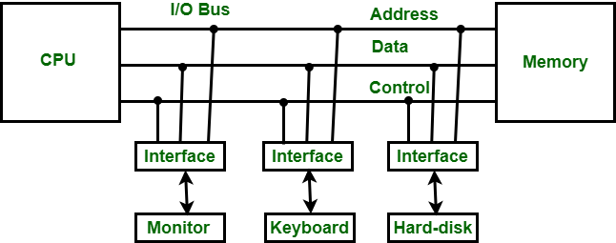
I/O Bus and Interface Modules
The I/O bus consists of data lines, address lines and control lines.
It is used as an method which helps in transferring of information between the internal storage devices i.e. memory and the external peripheral device . A peripheral device is that which provide input and output for the computer, it is also called Input-Output devices. For Example: A keyboard and mouse provide Input to the computer are called input devices while a monitor and printer that provide output to the computer are called output devices. Just like the external hard-drives, there is also availability of some peripheral devices which are able to provide both input and output.

Slide 6
Functions of Input-Output Interface
To resolve these differences, computer systems include special hardware components (Interfaces) between the CPU and peripherals to supervise and synchronize all input and output interfaces.
Functions of Input-Output Interface:
It is used to synchronize the operating speed of CPU with respect to input-output devices.
It selects the input-output device which is appropriate for the interpretation of the input-output signal.
It is capable of providing signals like control and timing signals.
In this data buffering can be possible through data bus.
There are various error detectors.
It converts serial data into parallel data and vice-versa.
It also convert digital data into analog signal and vice-versa.

Slide 7
Functions of an Interface
Decodes the device address (device code).
Decodes the commands (operation).
Provides signals for the peripheral controller.
Synchronizes the data flow and supervises the transfer rate between peripheral and CPU or Memory.
There are four types of IO command:
Control Command , Status Command
Output Data Command, Input Data Command
Each peripheral device has associated with it an interface unit.
Each interface decodes the address and control received from I/O bus,
interprets them for the peripheral.
Provides signal for the peripheral controller.
It also synchronizes the dataflow and supervises the transfer between peripheral and processor.

Slide 8
Functions of an Interface
An interface receives any of the following four commands −
Control − A command control is given to activate the peripheral and to inform its next task. This control command depends on the peripheral, and each peripheral receives its sequence of control commands, depending on its mode of operation.
Status − A status command can test multiple test conditions in the interface and the peripheral.
Data Output − A data output command creates the interface counter to the command by sending data from the bus to one of its registers.
Data Input − The data input command is opposite to the data output command. In data input, the interface gets an element of data from the peripheral and places it in its buffer register.

Slide 9
Isolated I/O versus Memory Mapped I/O
Isolated I/O
Separate I/O read/write control lines in addition to memory read/write control lines.
Separate (isolated) memory and I/O address spaces.
Distinct input and output instructions.
Memory-mapped I/O
A single set of read/write control lines (no distinction between memory and I/O transfer).
Memory and I/O addresses share the common address space which reduces memory address range available.
No specific input or output instruction so the same memory reference instructions can be used for I/O transfers.
Considerable flexibility in handling I/O operations.

Slide 10
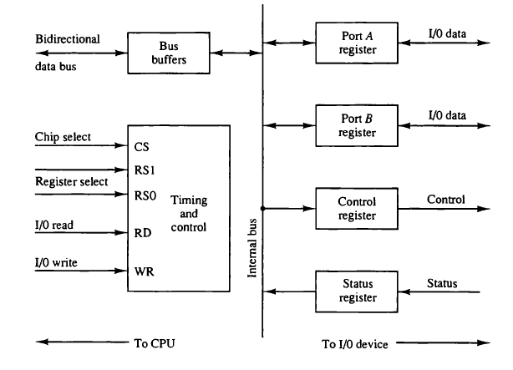
Example of I/O Interface

Slide 11
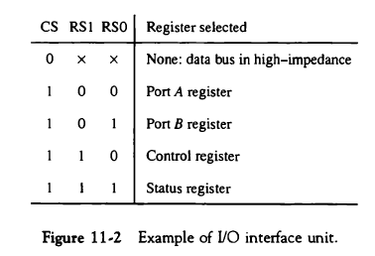
Example of I/O Interface

Slide 12
Example of I/O Interface
Information in each port can be assigned a meaning depending on the mode of operation of the I/O device:
Port A = Data; Port B = Command; Port C = Status
CPU initializes (loads) each port by transferring a byte to the Control Register
Allows CPU can define the mode of operation of each port
Programmable Port: By changing the bits in the control register, it is possible to change the interface characteristics

Slide 13
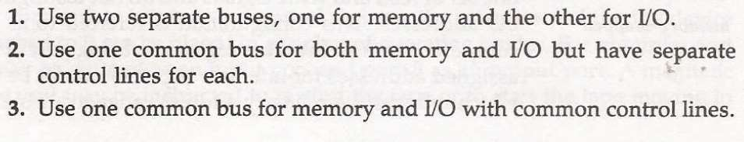
IO versus Memory bus
Like IO bus Memory bus also contain data, address and control lines.
There are 3 ways in which computer bus communicates with memory and IO.
https://www.geeksforgeeks.org/io-interface-interrupt-dma-mode/

